Slide 1

INFO 7250 Final Project Flight On-time Performance Analysis
Yunan Shao

Slide 2
Introduction
Air transport is now very common for travelling. Although, it is the fastest method of transport, passengers waste both time and money when their flights are delayed.
This project use the flight dataset to analyze the flight on-time performance and try to implement a machine learning model to predict if a flight will be delayed.
Possible Questions:
During which time period does flight delay the most?
Relations between Airports’ air traffic and flight delay.
Airliner on-time performance.

Slide 3
Objective & Techniques
1. Analyze the flight on-time performance from different aspects (time, airport and carriers) and provide visualized results
MultipleOutput Binning
MapReduce, Job Chaining
MultipleInput Reducer side Join
TopK Pattern
Combiner, Memory-Conscious Implementation
Custom Writable for processing selected attributes
2. Try to implement machine learning model for prediction flight delay
Apache Mahout
AWS Machine Learning

Slide 4
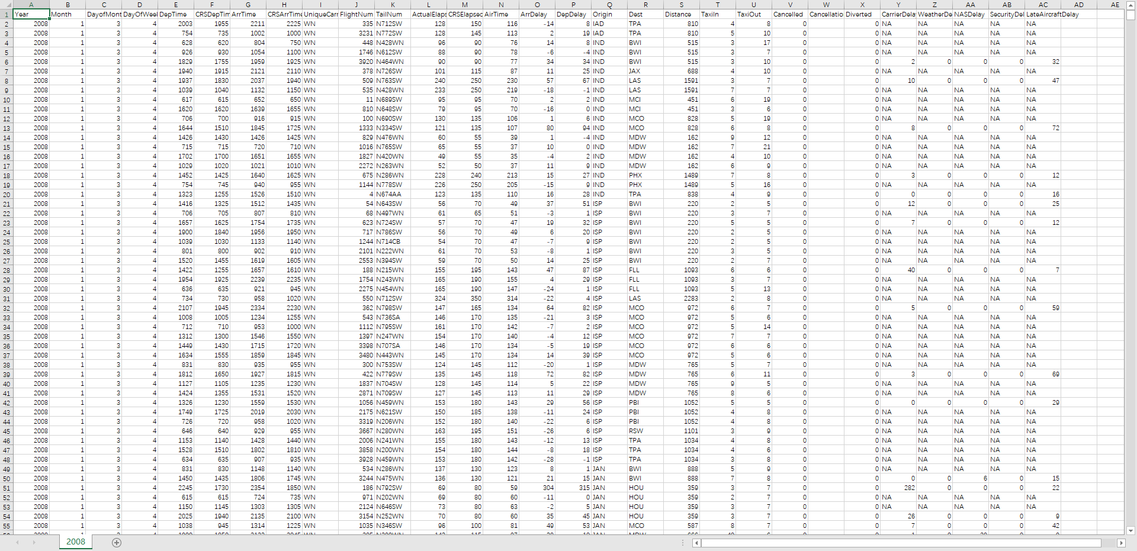
Dataset Flight Data From 1987 to 2008
http://stat-computing.org/dataexpo/2009/the-data.html

Slide 5
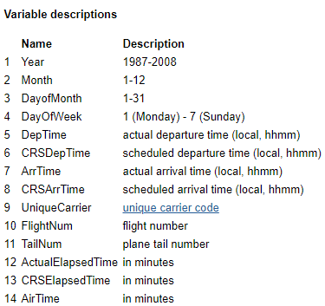
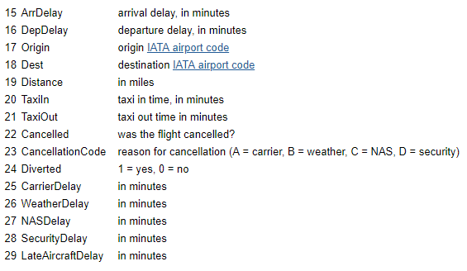
Field Attributes
Most of analyses are using files from 2003-2008 because these fields are ‘NA’ before 2003

Slide 6
Type of Delay
Carrier Delay
Carrier delay is within the control of the air carrier. Examples of occurrences that may determine carrier delay are: aircraft cleaning, aircraft damage, awaiting the arrival of connecting passengers or crew, baggage, bird strike, cargo loading, catering, computer, outage-carrier equipment, crew legality (pilot or attendant rest), damage by hazardous goods, engineering inspection, fueling, handling disabled passengers, late crew, lavatory servicing, maintenance, oversales, potable water servicing, removal of unruly passenger, slow boarding or seating, stowing carry-on baggage, weight and balance delays.
Late Arrival Delay
Arrival delay at an airport due to the late arrival of the same aircraft at a previous airport. The ripple effect of an earlier delay at downstream airports is referred to as delay propagation.
NAS Delay
Delay that is within the control of the National Airspace System (NAS) may include: non-extreme weather conditions, airport operations, heavy traffic volume, air traffic control, etc. Delays that occur after Actual Gate Out are usually attributed to the NAS and are also reported through OPSNET.
Security Delay
Security delay is caused by evacuation of a terminal or concourse, re-boarding of aircraft because of security breach, inoperative screening equipment and/or long lines in excess of 29 minutes at screening areas.
Weather Delay
Weather delay is caused by extreme or hazardous weather conditions that are forecasted or manifest themselves on point of departure, enroute, or on point of arrival.

Slide 7
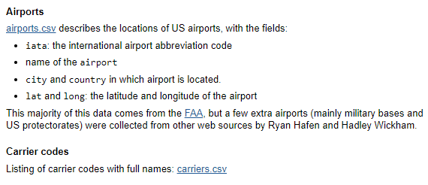
Supplemental Data
Airport and Carrier tables for JOIN in MapReduce Jobs
* The Federal Aviation Administration (FAA) considers a flight to be delayed when it is 15 minutes later than its scheduled time.

Slide 8

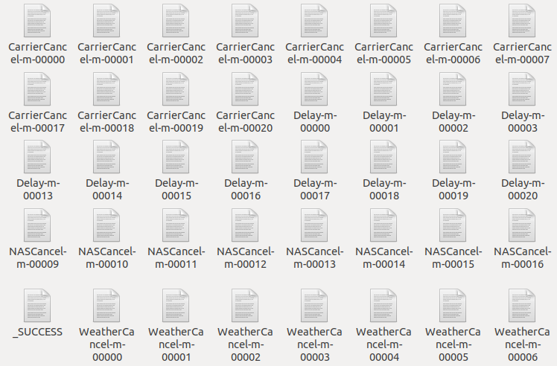
Inspection on the Dataset
Because the dataset is too large, even one csv file takes too long to load. In order to inspect the data, I use MultipleOutput for binning. (mapper and reducer side)

Slide 9
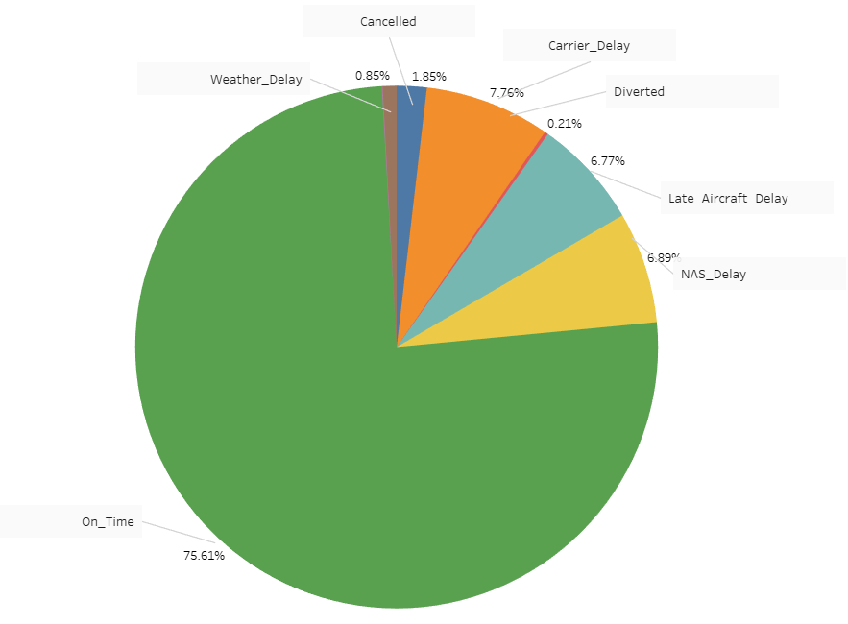
Causes of Delay 2003-2008
Main Causes
Carrier Delay
NAS Delay (National Airspace System)
Late Aircraft Delay
*Detailed results for each year can be accessed in Tableau file.

Slide 10
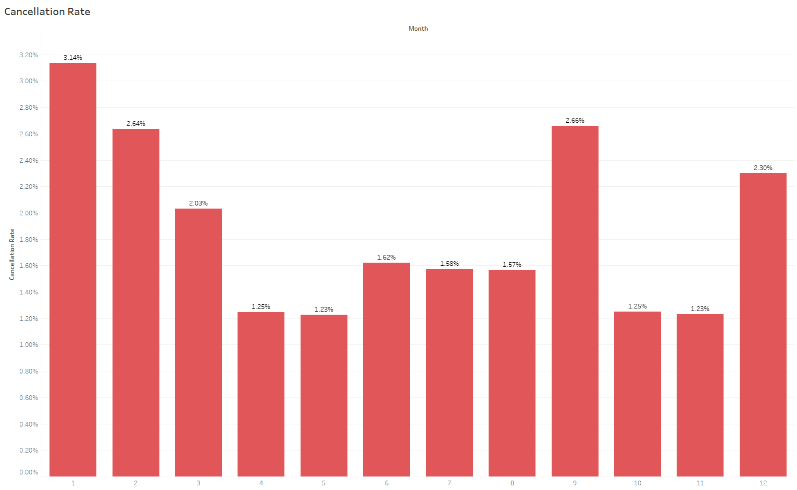
Cancellation Rate By Month

Slide 11
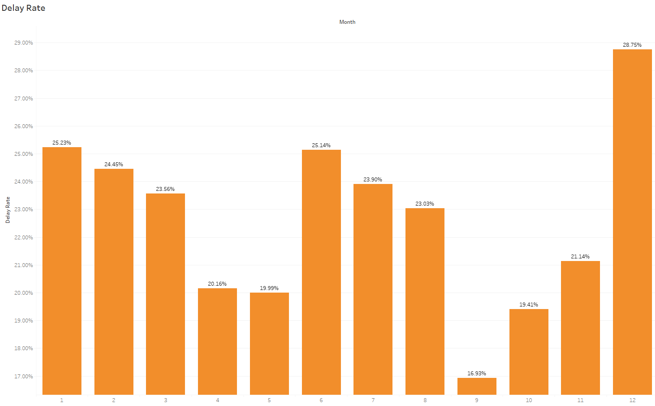
Delay Rate By Month

Slide 12
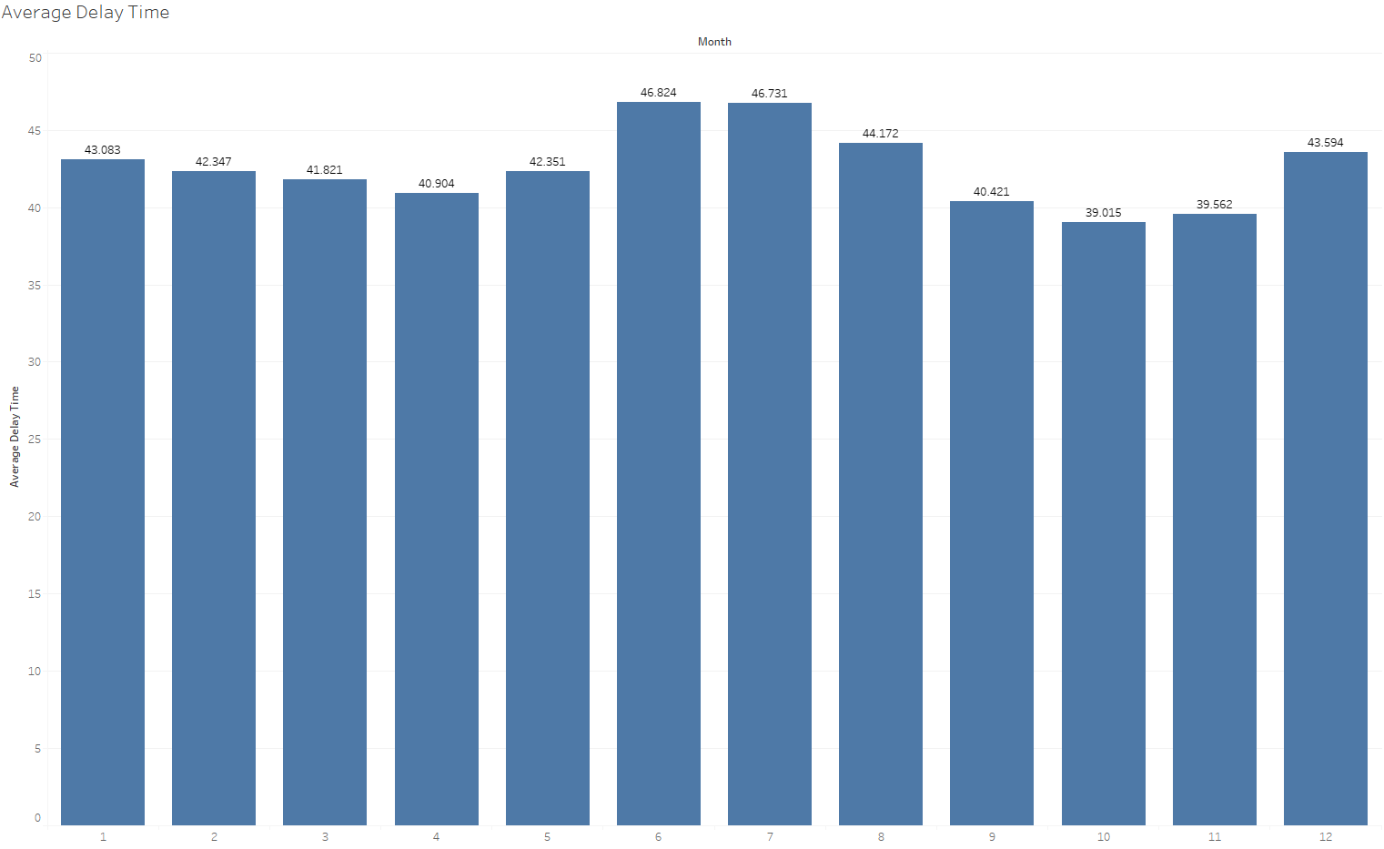
Average Delay Time By Month

Slide 13
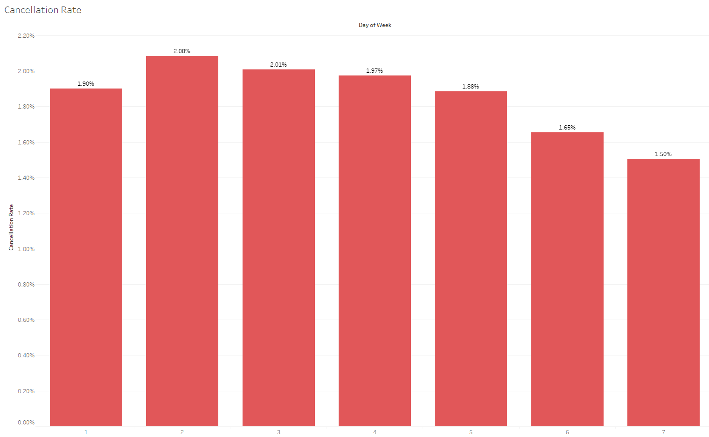
Cancellation Rate By Day of Week

Slide 14
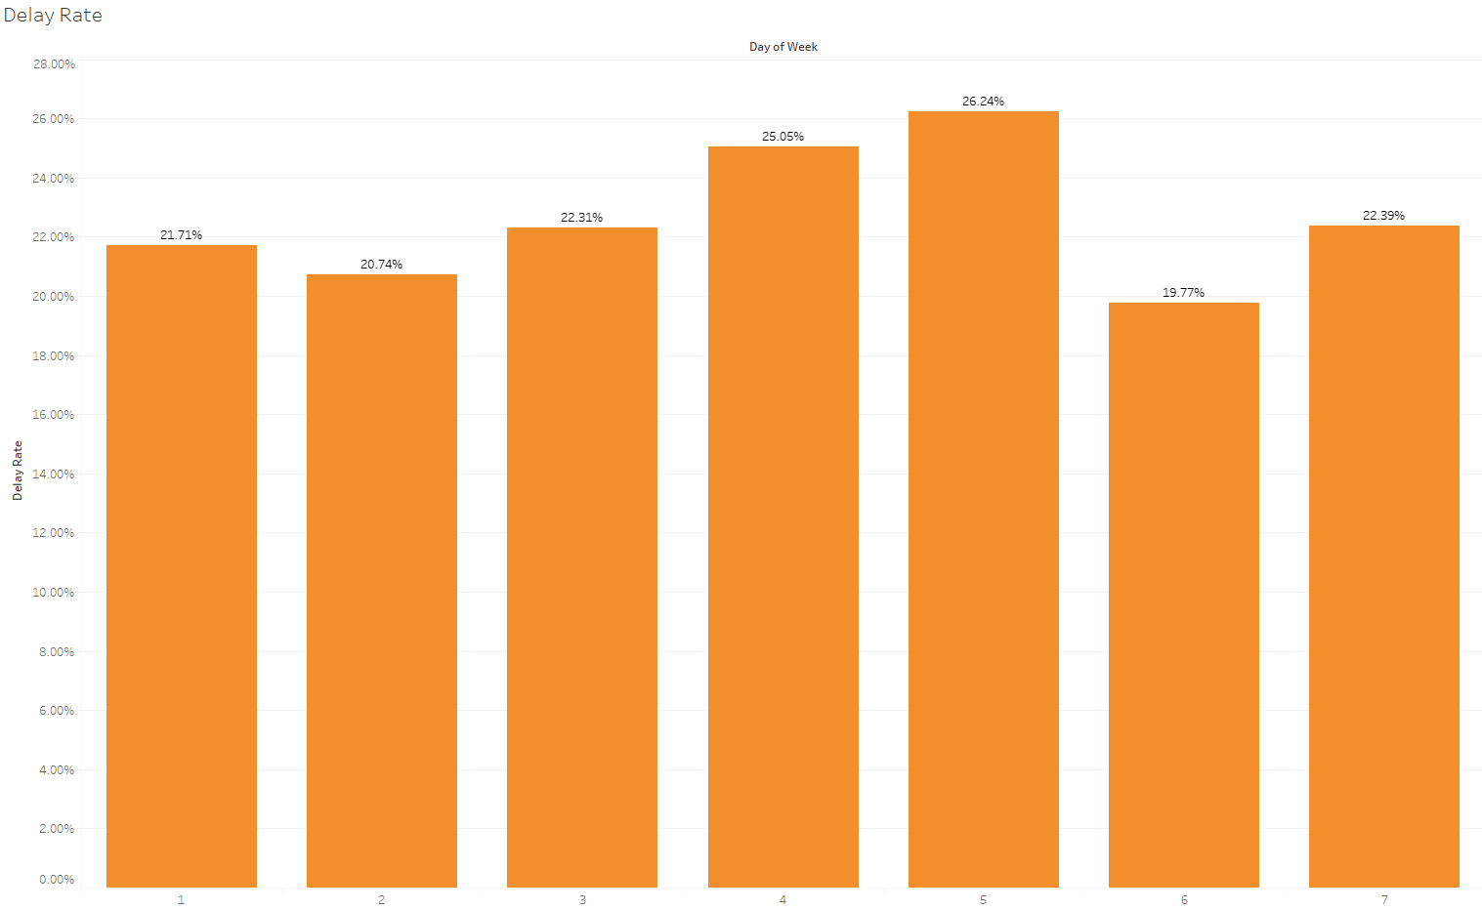
Delay Rate By Day of Week

Slide 15
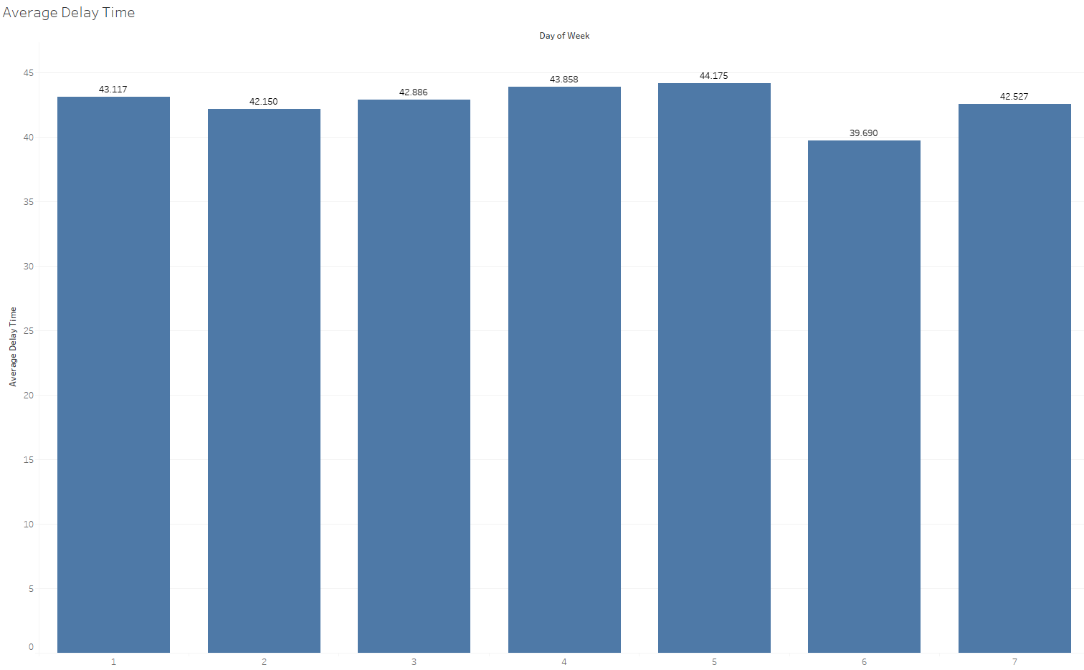
Average Delay Time By Day of Week

Slide 16
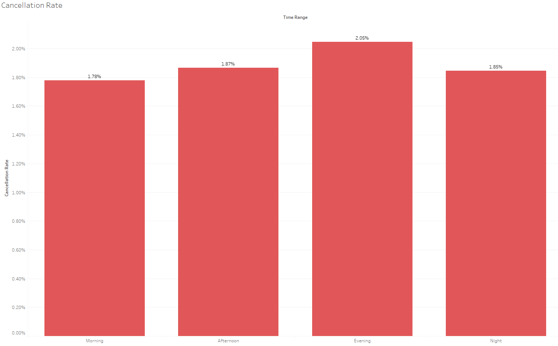
Cancellation Rate By Time Range

Slide 17
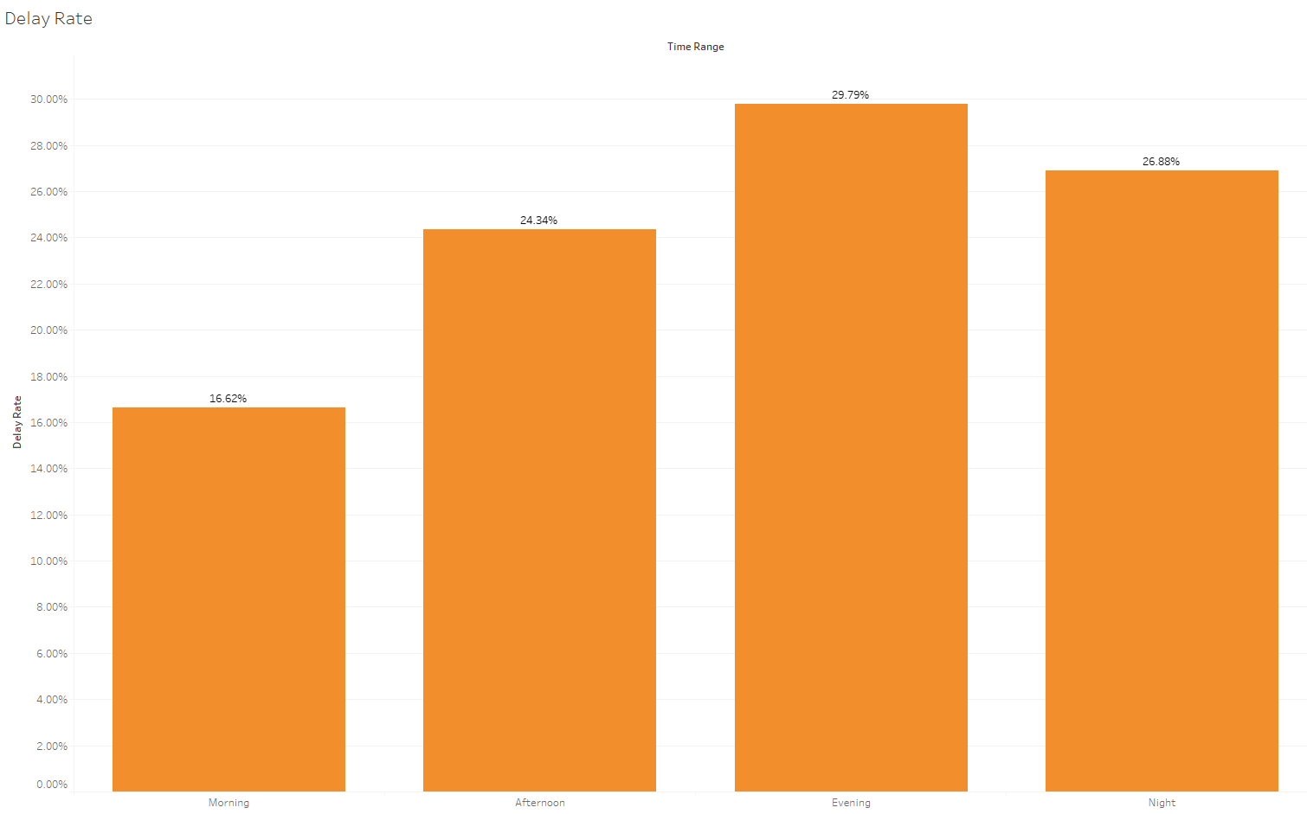
Delay Rate By Time Range

Slide 18
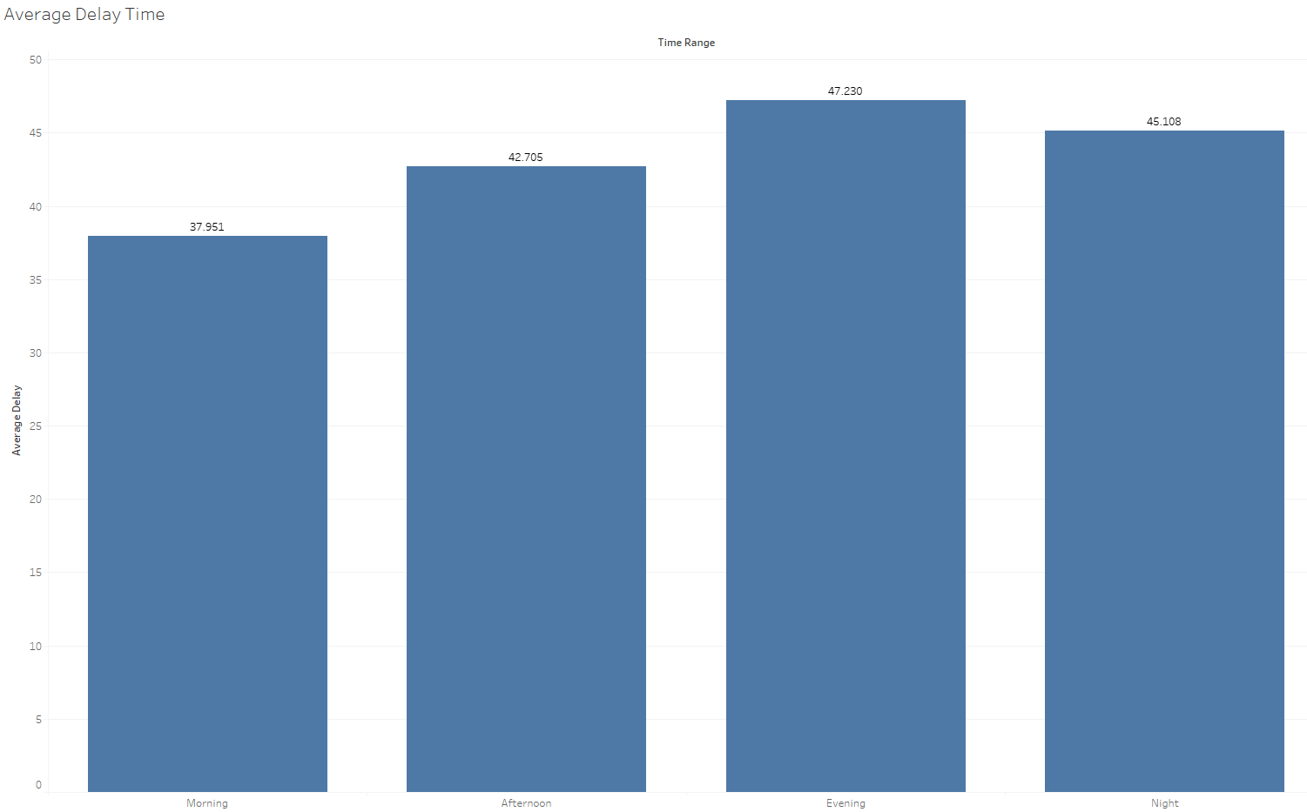
Average Delay Time By Time Range

Slide 19
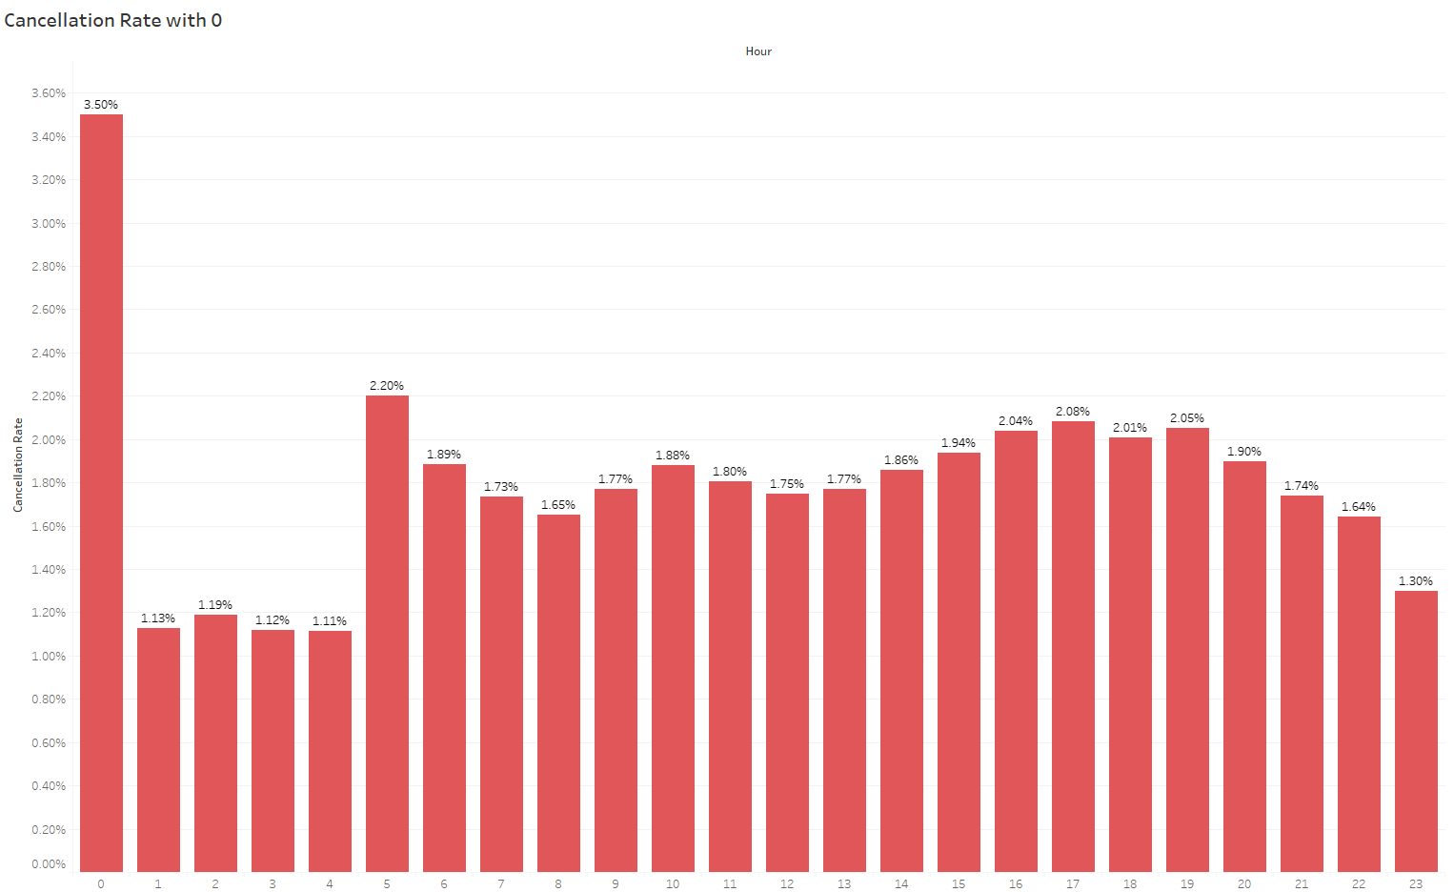
Cancellation Rate By Hour

Slide 20
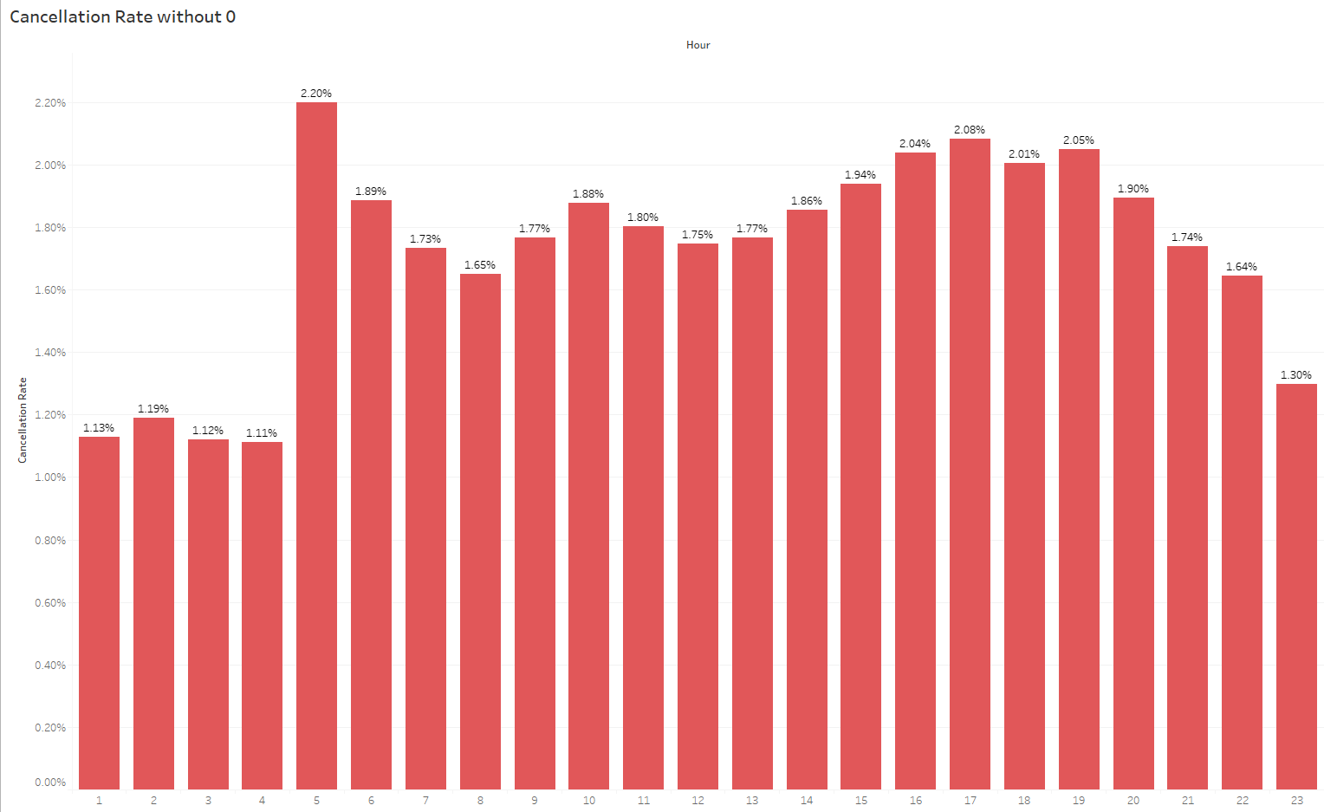
Cancellation Rate By Hour

Slide 21
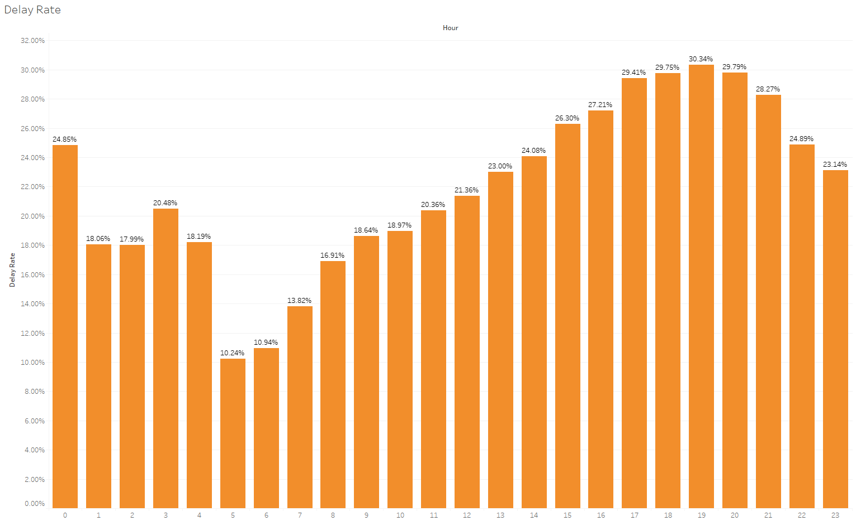
Delay Rate By Hour

Slide 22
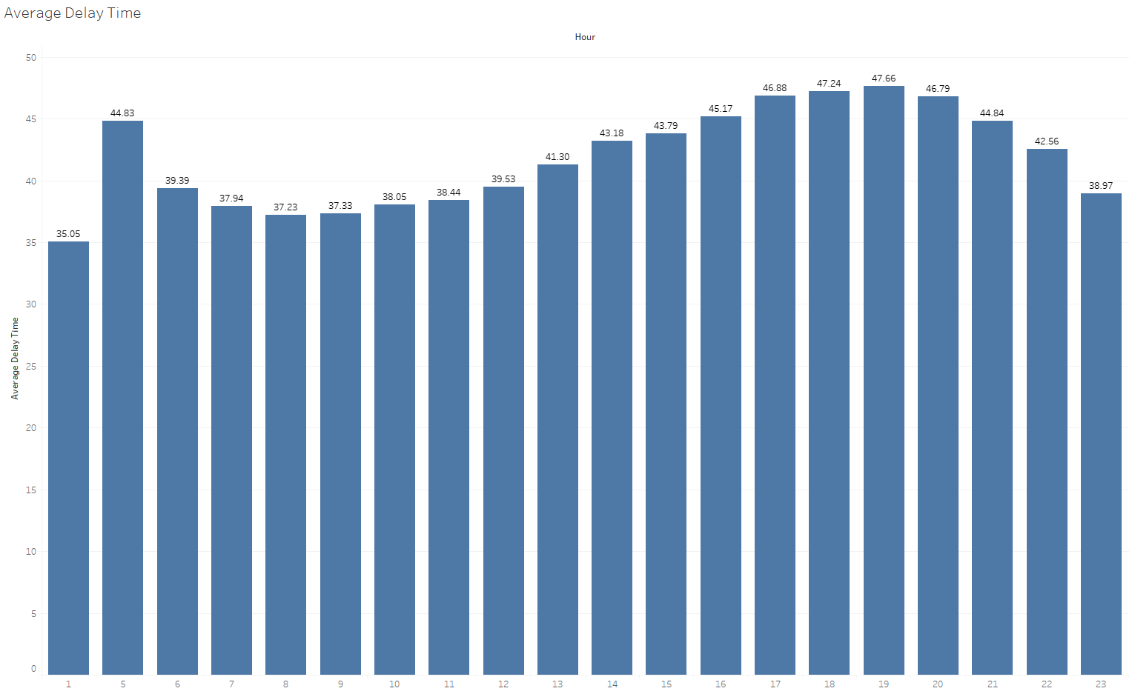
Average Delay Time By Hour

Slide 23
Time Analysis Summary & Conclusion
January, September and December have the highest cancellation rates December, January, and June have the highest delay rates. Possible causes are high traffic volume during winter holidays and Christmas from Dec to Jan. Summer holidays starts in June and ends in Aug.
Friday has the highest delay rate.
Evening period (especially 6pm – 8pm) has the highest delay rate and relatively high cancellation rate.
Not enough information to know why night especially midnight has higher cancellation rate. The cancellation rates are ‘NA’ even in most of the records in 03-08 files.
*Detailed results for each year can be accessed in Tableau file.

Slide 24
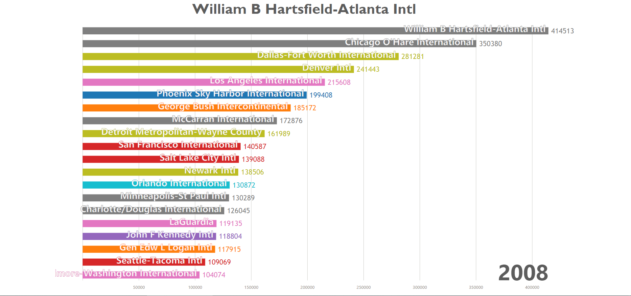
Top 20 Airports 1987-2008 Number of Flights per Year
Dynamic chart. See d3js folder in codes

Slide 25
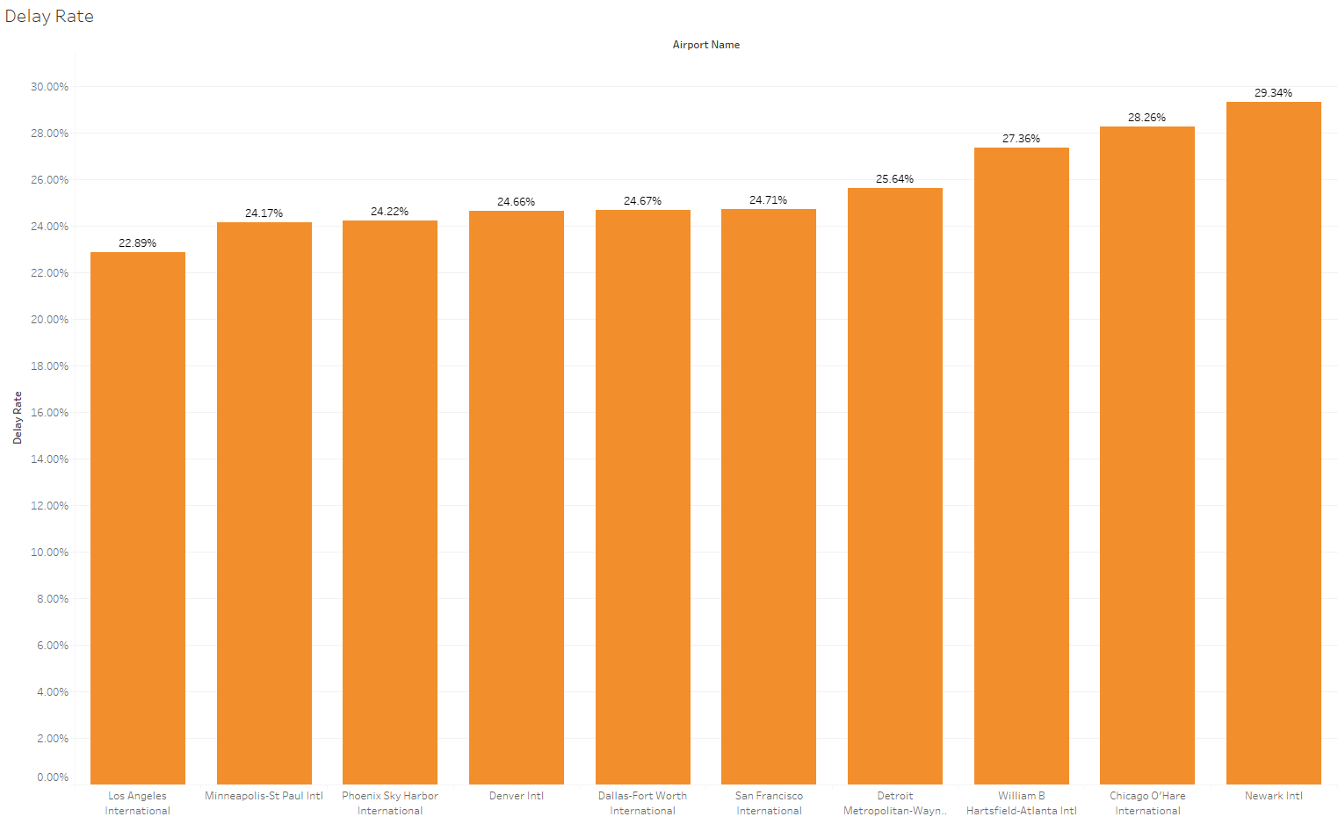
Top 10 Origin Airports Delay Rate

Slide 26
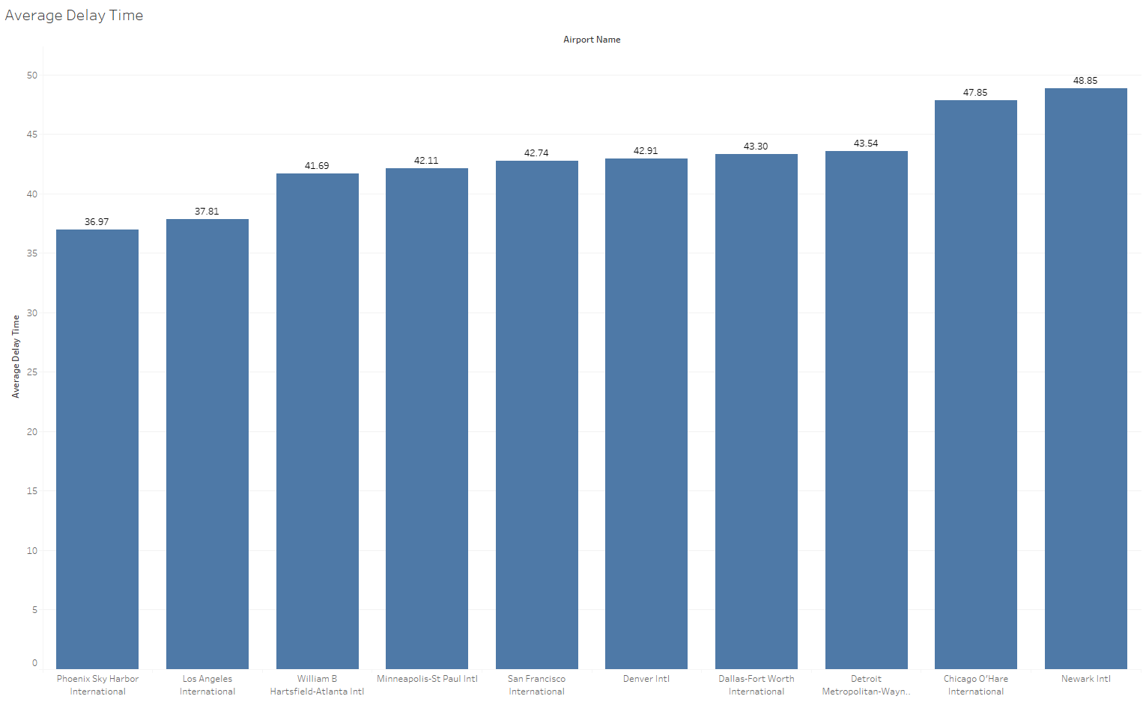
Average Delay Time

Slide 27
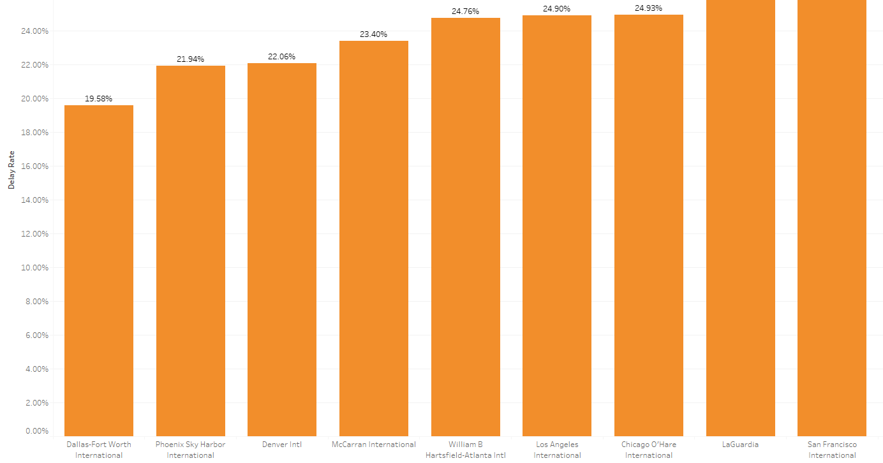
Top 10 Destination Airports Delay Rate

Slide 28
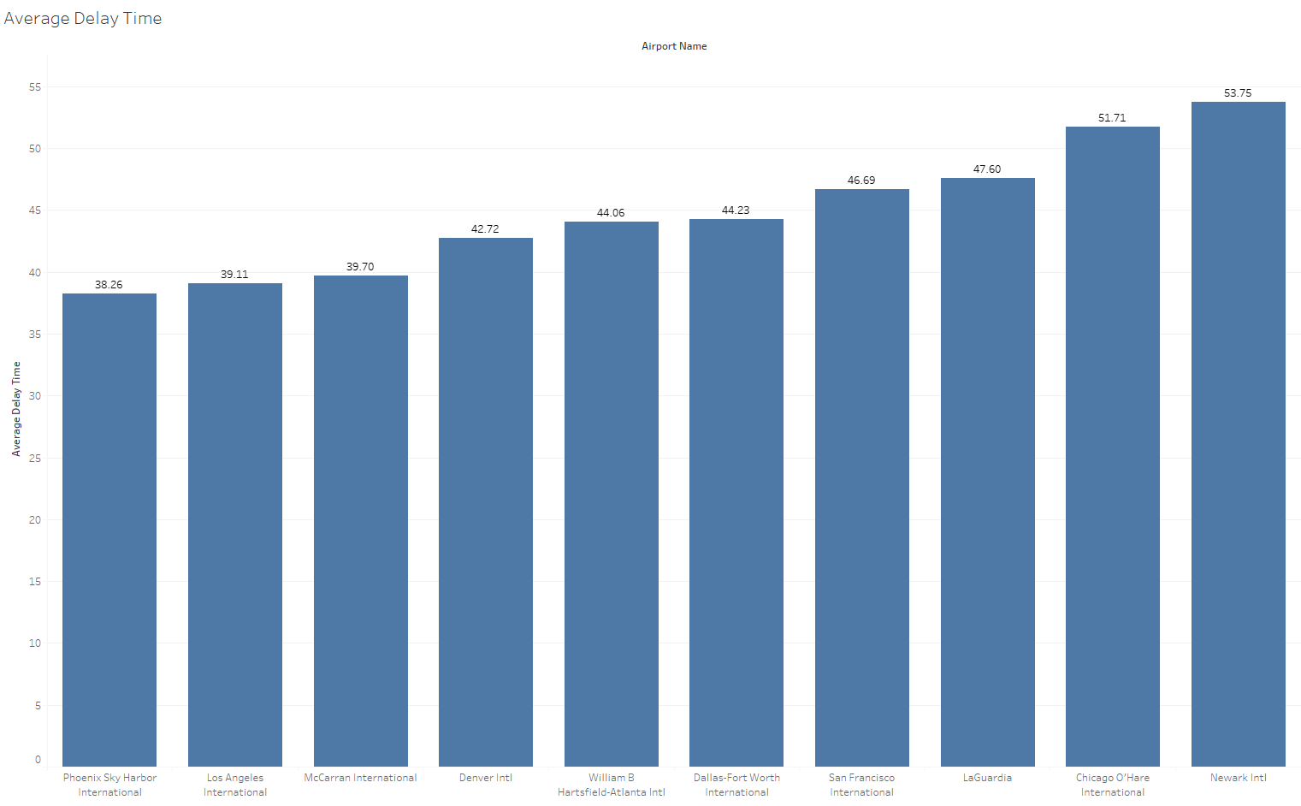
Average Delay Time

Slide 29
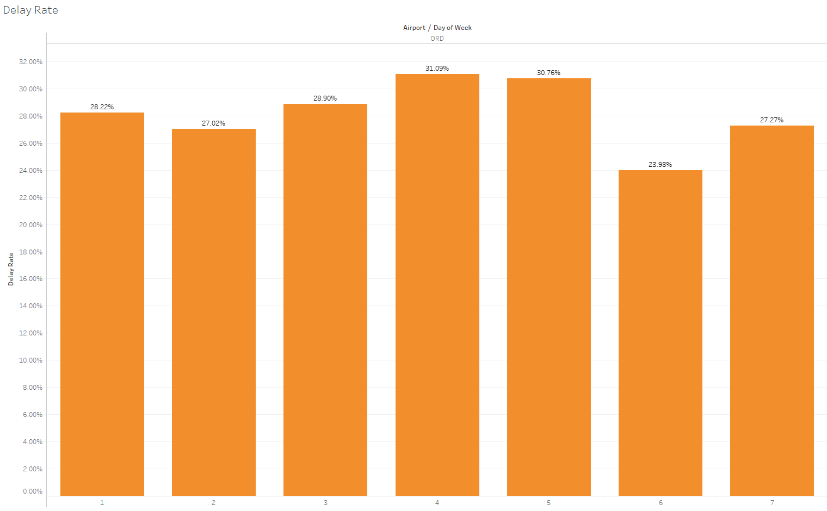
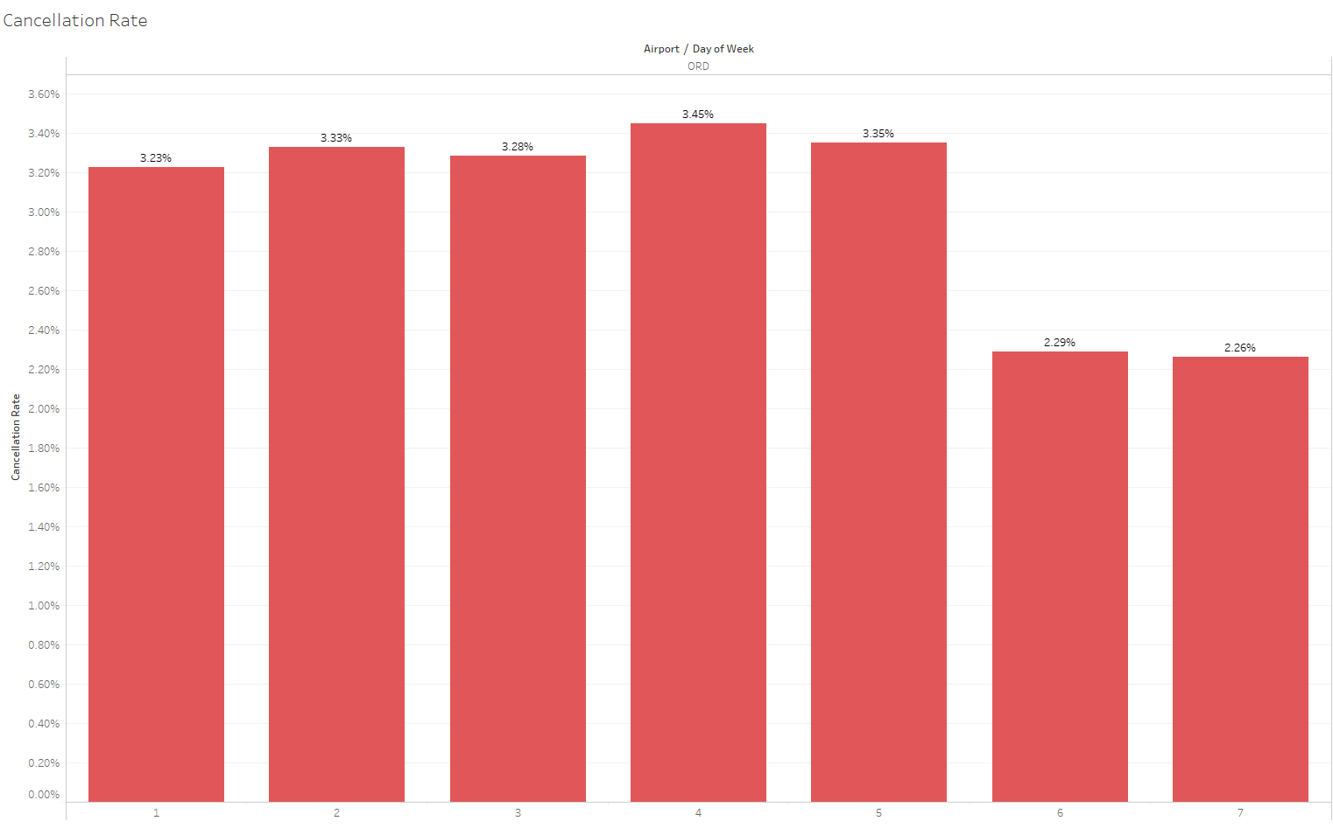
Airport Time Example Chicago O’Hare

Slide 30
Airport Analysis Conclusion
Atlanta, Chicago and Dallas have top total number of flights through all time.
Newark Intl is the worst airport to travel as both origin and destination, it has the highest delay rate and average delay time.
Chicago, Atlanta, Detroit have relatively high delay rate as origin
As a destination, San Francisco has almost the same delay rate as Newark
If consider the airports with high number of delayed flights and delayed rate both as busy, most of them have also higher total number of flights
*Detailed results for each year can be accessed in Tableau file.

Slide 31
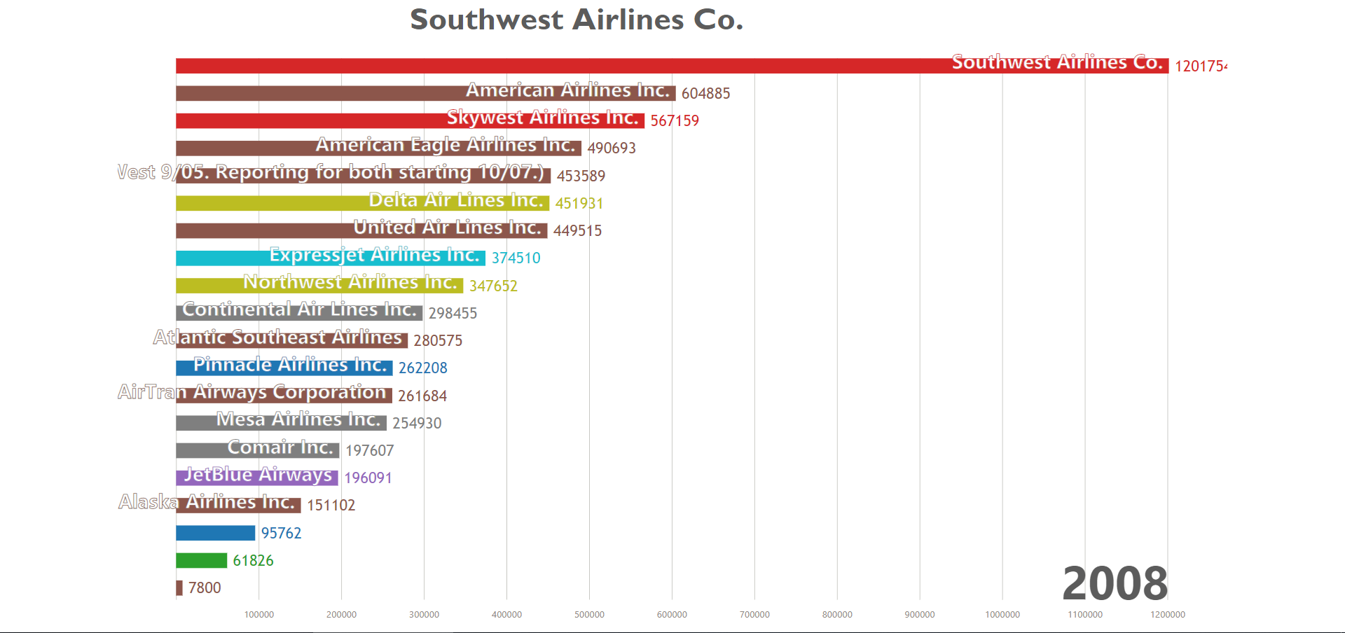
Total Number of Flights By Carriers 1987-2008
Dynamic chart. See d3js folder in codes

Slide 32
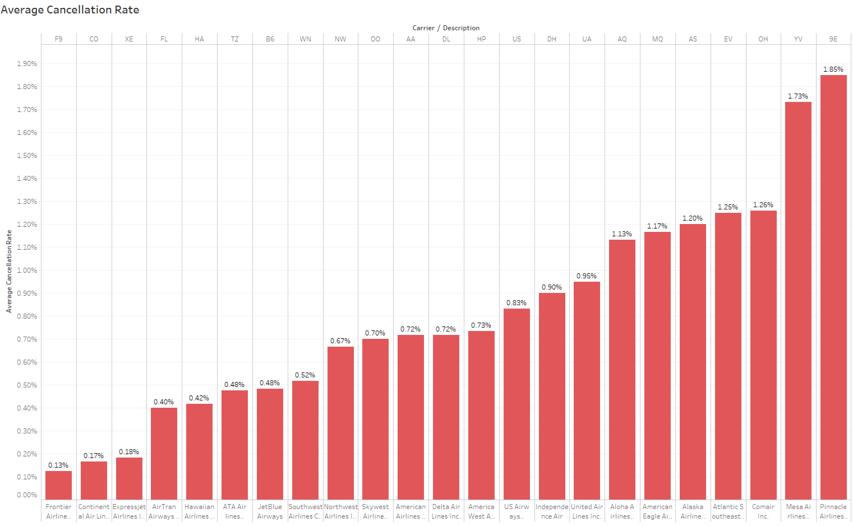
Cancellation Rate

Slide 33
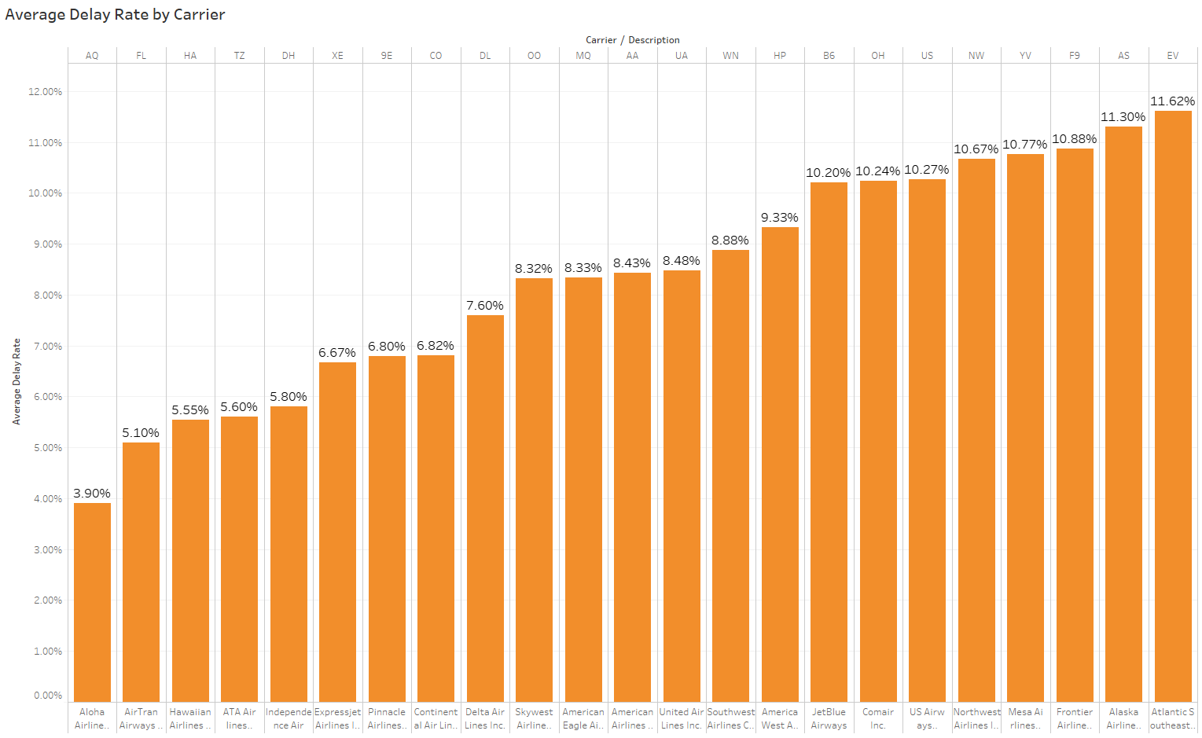
Delay Rate

Slide 34
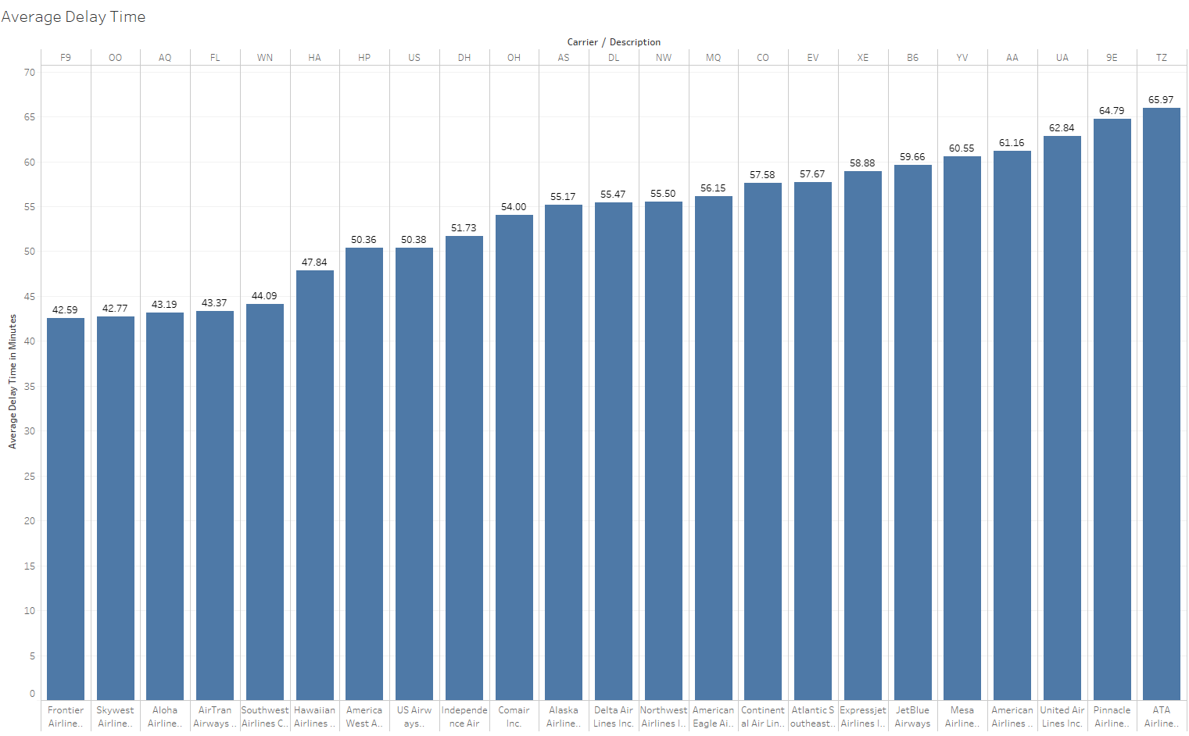
Average Delay Time

Slide 35
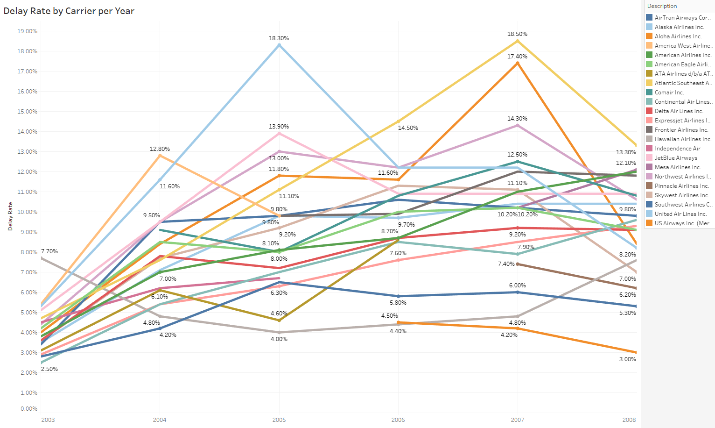
Delay Rate Line Chart 2003-2008

Slide 36
Carrier Analysis Conclusion
The carrier performance analysis only counts the records with carrier delay as the main reason of the delay
Pinnacle and Mesa have highest average cancellation rates
Atlantic Southeast and Alaska have highest average delay rates
Airlines that delay rates keep raising: American Airlines, Continental, ExpressJet
Alaska, Us Airways, Atlantic Southeast, US Airways, SkyWest and Northwest have big improvements in recent one year
Aloha Airline is a small carrier and started service at 2006 but has lowest average delay rate and still improving
*Detailed results for each year can be accessed in Tableau file.

Slide 37
Travel Advice
Passengers should avoid peak time period such as the evening. Avoid travelling in busy month is not really possible if they have a travel plan but they can still try to book flights in the morning, afternoon or early night.
Another possible way is to rearrange the day you fly, for example flying on Saturday will be better than Friday.
If your origin or destination airport is a big one, consider again to avoid peak time. (ORD example shows Saturday is much more better even for a busy airport)
Booking flights operated by carriers have better on-time performance and avoid bad ones such as Atlantic SouthWest.

Slide 38
Machine Learning (Attempt) Data Preparation
Use 2008.csv as sample data. Similar patterns for both implementations. MapReduce to get training data then train the model with selected fields.
Fields Selected
1. Month
2. DayofWeek
3. CRSDepTime (Scheduled Departure Time) - Hour
4. Carrier
5. Origin
6. Dest
*7. Delayed(0-not delayed, 1-delayed) arrdelay>=15 minutes

Slide 39
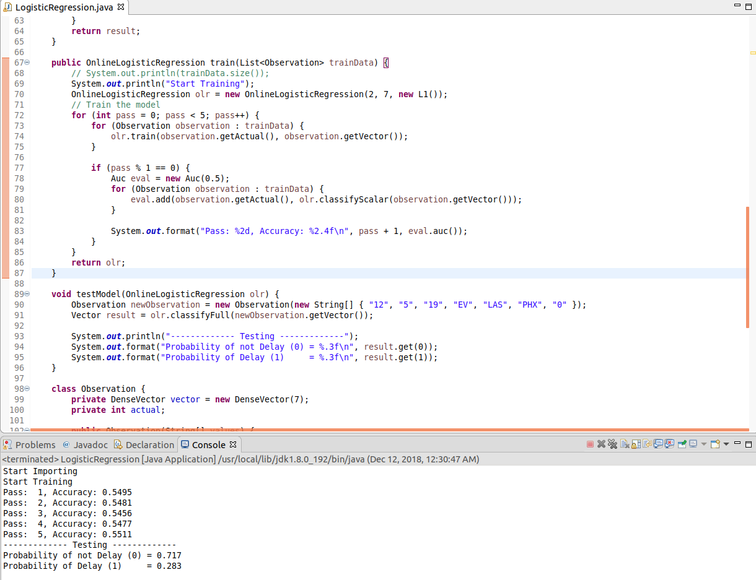
Apache Mahout OnlineLogisticRegression

Slide 40
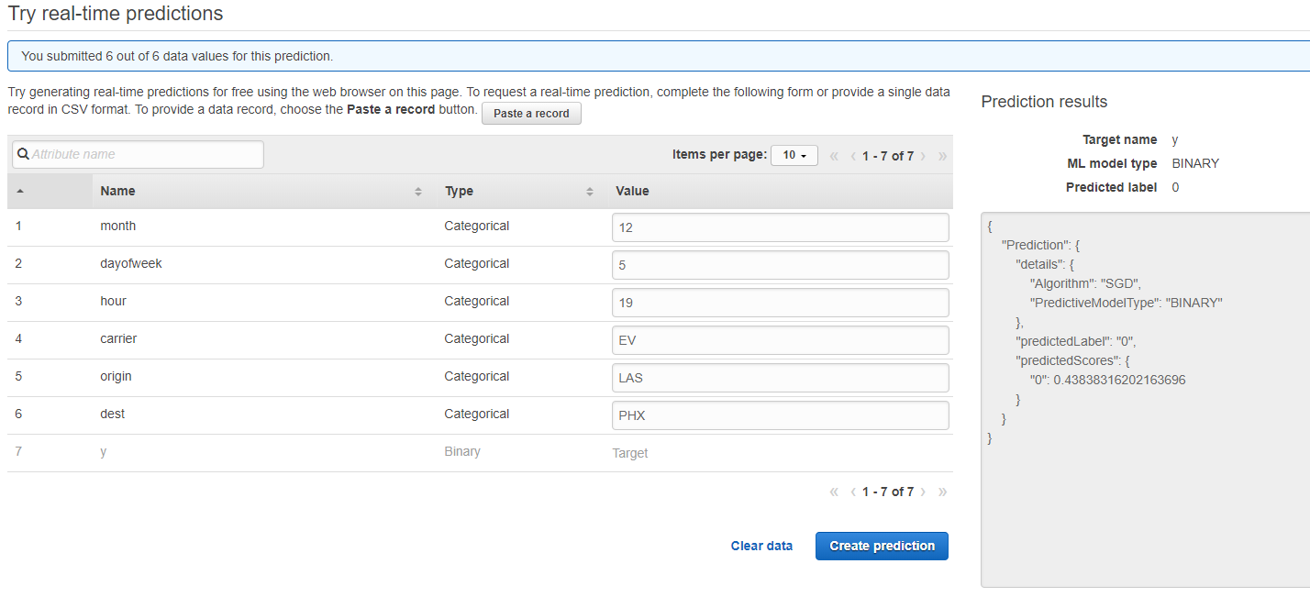
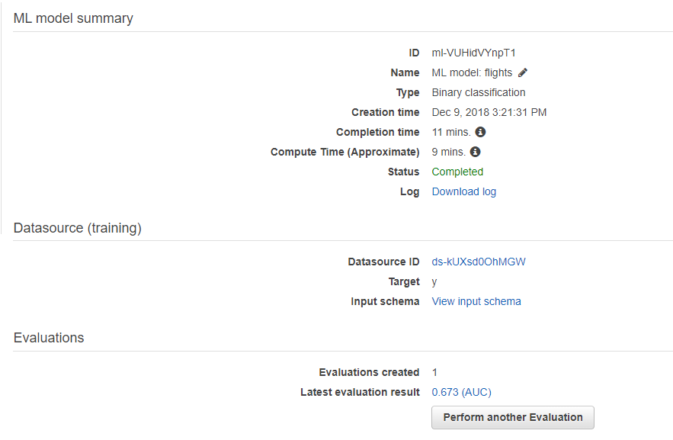
AWS Machine Learning

Slide 41
Machine Learning Conclusion
The accuracy of my prediction model is not good enough (best 60% and average 55%). One of the reason could be that Apache Mahout is normally used for recommendation and classification model. It’s very hard to find a detailed guide showing how to implement the logistic regression and tune the model.
The AWS Machine Learning Model has a better score (67%) but still not good enough. I have tried to used MapReduce to get training data with different parameters but this is the only one data that I have successfully imported to the model due to the permission problem of S3 bucket.

Slide 42
Additional Ideas
Selecting datasets with such big time range is good for showing results through years such as performance trending. However, making recommendations with average/overall result may not be a good idea since airports and carriers operate differently because of the increased air traffic and more advanced technologies they use.
For prediction using machine learning, the idea is similar to the first one. My opinion is to use most recent data (2-3 years) to increase the performance of the prediction model. Another possible reason that my models don’t get ideal scores is I don’t have the weather data. There are weather cancellations and delays in the data and the weather data could be related to the month results in some seasons such as Summer and Winter (Storm, Snow).

Slide 43
References
Apache Mahout OnlineLogisticRegression example
http://technobium.com/logistic-regression-using-apache-mahout/
D3.js
https://github.com/d3/d3
https://github.com/Jannchie/Historical-ranking-data-visualization-based-on-d3.js

